Slide 1

Computer Engineering Department
A.P. Shah Institute of Technology
G.B.Road,Kasarvadavli, Thane(W), Mumbai-400615
UNIVERSITY OF MUMBAI
Academic Year 2021-2022

Slide 2
A Project Report on
Chatbot
Submitted in partial fulfillment of the degree of
Bachelor of Engineering(Sem-7)
in
Computer Engineering
By
Mansi Shah(18102002)
Apoorva Talesara(18102027)
Zoha Shaikh(19202006) Isha Phadkar(18102060)
Under the Guidance of
Prof. Sukhada Aloni

Slide 3
1.Project Conception and Initiation

Slide 4
1.1 Abstract
In this modern age where every detail of an organization is available on their respective website, third parties looking for any information have to ransack through the entire website for the right information. So to tackle this issue the governing organizations need to spend resources on manpower which then assist the user when needed and the users don’t get the information they need as quickly as possible and this method is not efficient. So to solve this problem we are going to develop a chatbot that can provide the users with the information that they need as quickly as possible.
A Chatbot is a software application that mimics a genuine person for reenacting a conversation. The main aim of the chatbot developed is to reduce the time that user spends in finding the correct information.
Chatbot can be described as software that can chat with people using artificial intelligence. This software is used to perform tasks such as quickly responding to users, informing them, helping to purchase products and providing better service to users.

Slide 5
1.2 Objectives
To increase user satisfaction by giving them the information in time.
To increase time efficiency. To reduce waiting time as the chatbot can process large volume of requests at the same time without a delay.
To reduce response time. To increase the availability for answering the user questions as the chatbot is available 24/7.
To increase the accessibility of the website.

Slide 6
1.3 Literature Review
Chatbots have been in use for educational purposes for quite some time. These Chatbots can be categorized into those with education intentionality and those without. Chatbots without education intentionality is used in administrative tasks such as student guidance and assistance.
Chatbots with education intentionality are used in fostering teaching and learning. Within this category, there are Chatbots which provide the framework of the learning process, that is, select and arrange contents to fit the students’ needs and speed, and help in reflection and learning motivation. These bots act as a learning companion which provides dialogue, collaboration and reflection. Furthermore, there are exercise and practice
Chatbots that present a stimulus in question form, to which the student provides an answer that is assessed by the Chatbot which then provides feedback.

Slide 7
1.4 Problem Definition
It is difficult to find information on the college website where there are various pages, instead if there is a chatbot on the college website it provides information to the user easily and efficiently with consistent answers every time.
Keyword recognition chatbot type is a type of chatbot that helps provide a user experience.
Unlike the Menu button chatbot, the Keyword Recognition chatbot hearkens to what humans have to say and, based on the information provided, tries to answer queries. A chatbot can be considered as an intermediary AI because the chatbot tries finding the appropriate related words which it then associates with the knowledge given to it and returns the response to the user. Most user-provided queries can be solved by the chatbot, but in case the user requires off-topic knowledge or when the chatbot's knowledge is insufficient, it will respond with “we will get back to you later. For more details, contact:”.
As our college website does not have a chatbot, we are trying to introduce it on our website.

Slide 8
1.5 Scope
In this project we are making a college specific chatbot system that can be custom fitted to education domain chatbot, the addition of this chatbot system in the college website will make the webpage more user interactive as it responds to the user queries very accurately as it is a domain specific chatbot system, and furthermore we had investigated our college chatbot system design stages and a few different techniques by which the precision of the chatbot system can be made much better.
To make the responses given by the chatbot system more meaningful and accurate the administrator has to train the chatbot system with more information regarding to college and increase the scope of knowledge base. Nevertheless, gathering feedback from the potential user can be helpful in developing the college Chatbot system, ultimately servicing the user queries.
The purpose of developing this project is based on an intellectual chat-bot system which will deal with the academic activities like admission enquiry, payment portal, Moodle e-learning system, apsit skills, extra-curricular activities, etc. With this chatbot system it will be easy for the student to directly clear their queries in lesser time.

Slide 9
1.6 Technology stack
Natural language processing (NLP) is the ability of a computer program to understand human language as it is spoken and written -- referred to as natural language. It is a component of artificial intelligence (AI). NLP has existed for more than 50 years and has roots in the field of linguistics. It has a variety of real-world applications in a number of fields, including medical research, search engines and business intelligence. Businesses use massive quantities of unstructured, text-heavy data and need a way to efficiently process it. A lot of the information created online and stored in databases is natural human language, and until recently, businesses could not effectively analyze this data. This is where natural language processing is useful.
Natural language processing (NLP) uses machine learning (ML) systems to ingest and learn words and syntax. The inputs are then processed based on grammatical rules, linguistic habits, and standard algorithms to produce computer-based natural language. The technology can be used for language translations. In general terms, NLP tasks break down language into shorter, elemental pieces, try to understand relationships between the pieces and explore how the pieces work together to create meaning.

Slide 10
1.6 Technology stack
Software:
Jupyter Notebook
The Jupyter Notebook is an open-source web application that allows data scientists to create and share documents that integrate live code, equations, computational output, visualizations, and other multimedia resources, along with explanatory text in a single document.
Visual Studio Code
Visual Studio Code is a streamlined code editor with support for development operations like debugging, task running, and version control. It aims to provide just the tools a developer needs for a quick code-build-debug cycle and leaves more complex workflows to fuller featured IDEs, such as Visual Studio IDE.
Windows OS
Windows is a graphical operating system developed by Microsoft. It allows users to view and store files, run the software, play games, watch videos, and provides a way to connect to the internet. It was released for both home computing and professional works.
Hardware:
Processor: Intel i5
RAM: 8GB
Windows 10

Slide 11
1.7 Benefits for environment & Society
24-hour Availability: Chatbots allow users to get help at any time as they are available 24/7.
Instant Answers: Chatbots can handle the queries of thousands of users instantly as well as simultaneously and improve the average response time.
Consistent Answers: The use of chatbots can help to maintain a great level of consistency in answers.

Slide 12
2. Project Design

Slide 13
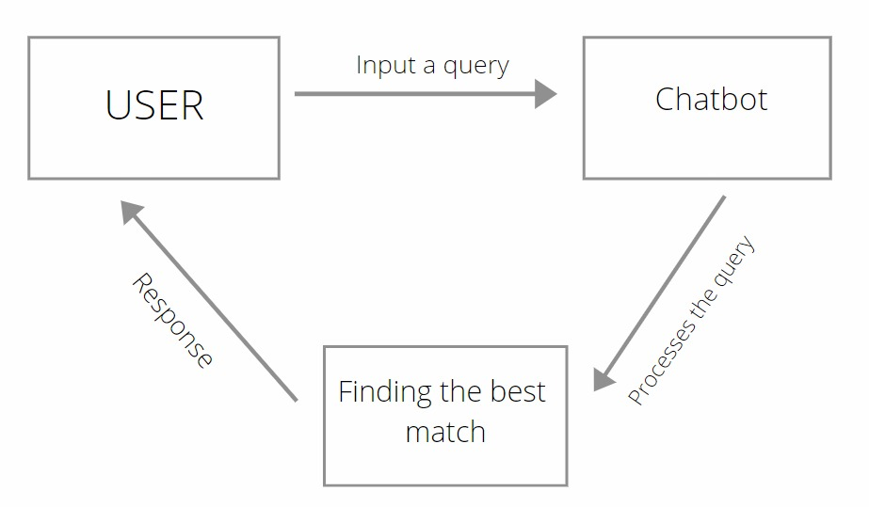
2.1 Proposed System

Slide 14
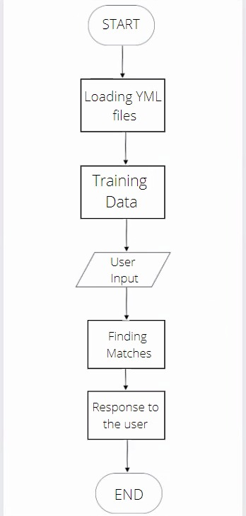
2.2 Design(Flow Of Modules)

Slide 15
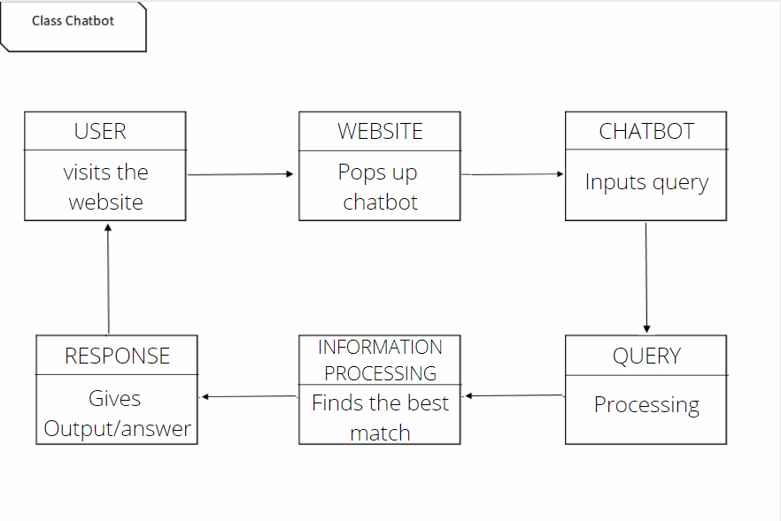
2.3 Class Diagram

Slide 16
2.4 Module-1 : ChatterBot
ChatterBot is a Python library that makes it easy to generate automated responses to a user’s input.
ChatterBot uses a selection of machine learning algorithms to produce different types of responses.
This makes it easy for developers to create chat bots and automate conversations with users.
The language independent design of ChatterBot allows it to be trained to speak any language.
Additionally, the machine-learning nature of ChatterBot allows an agent instance to improve it’s own knowledge of possible responses as it interacts with humans and other sources of informative data.

Slide 17
Module-2 : Platform used for Execution
Jupyter Notebook :
The Jupyter Notebook is an open source web application that you can useto create and share documents that contain live code, equations, visualizations, and text.
Jupyter Notebook is maintained by the people at Project Jupyter.
Jupyter Notebooks are a spin-off project from the IPython project, which used to have an IPython Notebook project itself.

Slide 18
The name, Jupyter, comes from the core supported programming languages that it supports:Julia, Python, and R. Jupyter ships with the IPython kernel, which allows you to write your programs in Python, but there are currently over 100 other kernels that you can also use.
Jupyter notebook is a client-server application.
The application starts the server on local machine and opens the notebook interface in web browser where it can be edited and run from.
The notebook is saved as ipynb file and can be exported as html, pdf and LaTex files.

Slide 19
2.5 References
https://www.oracle.com/in/chatbots/what-is-a-chatbot/
https://code.visualstudio.com/docs/editor/whyvscode
https://research.aimultiple.com/chatbot-benefits/
https://ieeexplore.ieee.org/document/9395818
https://www.javatpoint.com/windows

Slide 20
3.Planning for next semester

Slide 21
Planning
Building GUI for the chatbot
Adding Extra Features

Slide 22
Thank You

